Slide 1

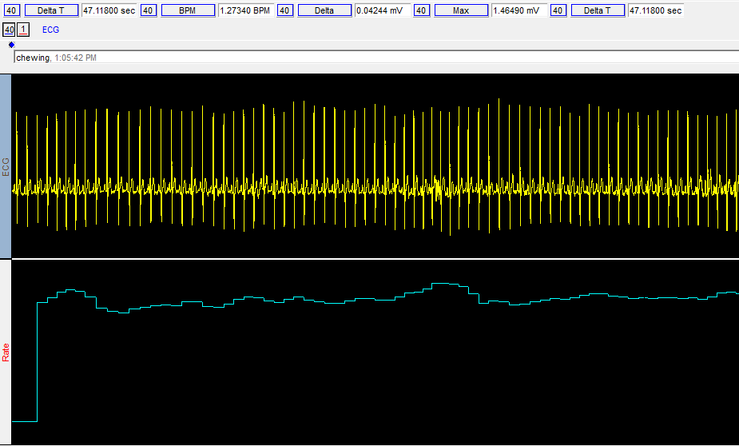
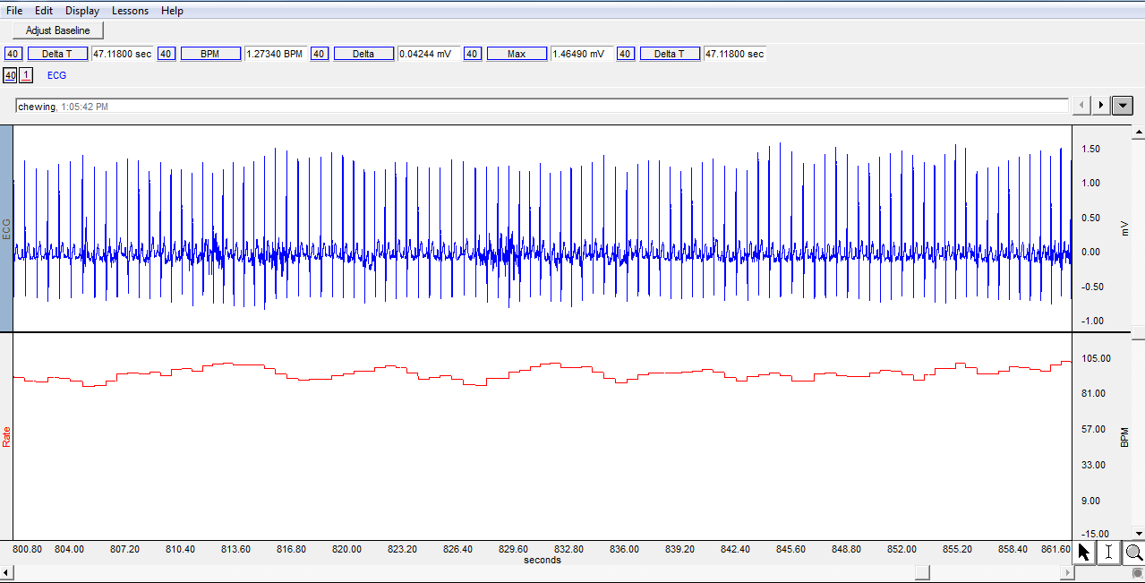
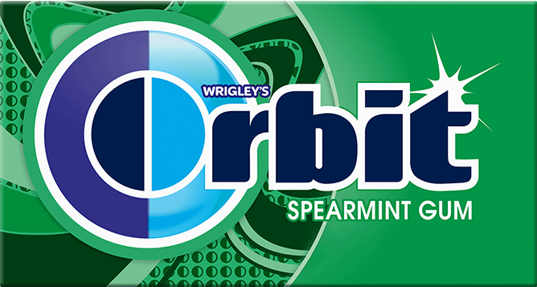
Influence of Chewing Gum on Stress
David Mastro & Kara Hess-Hover
Introduction
Research has shown that chewing gum can have an influence on stress. Chewing gum may lower stress by increasing reaction time to new stimuli (Smith, 2010). This is direct evidence of an increase in mental performance, which may be due to chewing gum’s ability to rid individuals of lapses in concentration, an ability hindered by stress (Smith, 2010).
In a fairly recent study, high-frequency gum chewers reported significantly lower amounts of perceived occupational anxiety than non-chewers (Smith, Chaplin, & Wadsworth, 2012).
While flavor is not necessary in reducing cortisol levels, it may increase effects in the anti-stress properties of chewing gum. In addition, flavored gum is a better promoter of a positive mood, which could further enhance its ability to counteract stress (Scholey et al., 2009).
Consistent mastication for 15 minutes is necessary for significant reduction in salivary cortisol (Walker et. al, 2016).
Numerous studies demonstrate the particular influence of peppermint and lemon on anxiety and stress. Exposure to peppermint oil results in an almost immediate lowered participative level of perceived stress. When chewing gum, the “chewer” tastes the flavor partly through smell. So, the peppermint aroma described in the previously mentioned study is most definitely an aspect of overall taste (Dong & Jacob, 2016; Toda & Morimoto, 2011).
References
Dong, S. &amp; Jacob, T. J. C. (2016). Combined non-adaptive light and smell stimuli lowered blood pressure, reduced heart rate and reduced negative affect. Physiology and Behavior, 156, 94-105. https://doi.org/10.1016/j.physbeh.2016.01.013
Scholey, A., Haskell, C., Robertson, B., Kenthedy, D., Milne, A., &amp; Wetherell, M. (2009). Chewing gum alleviates negative mood and reduces cortisol during acute laboratory psychological stress. Physiology and Behavior, 97(3-4), 304-312. https://doi.org/10.1016/j.physbeh.2009.02.028
Smith, A. P. (2010). Effects of chewing gum on cognitive function, mood, and physiology in stressed and nonstressed volunteers. Nutritional Neuroscience, 13(1), 7-15. doi:10.1179/147683010X12611460763526
Smith, A.P., Chaplin, K., & Wadsworth, E. (2012). Chewing gum, occupational stress, work performance and wellbeing. An intervention study. Appetite, 58(3), 1083-1086. https://doi.org/10.1016/j.appet.2012.02.052
Toda, M. &amp; Morimoto, K. (2011). Evaluation of effects of lavender and peppermint aromatherapy using sensitive salivary endocrinological stress markers. Stress and Health: Journal of the International Society for the Investigation of Stress, 27(5), 430-435. doi: https://doi.org/10.1016/j.pain.2005.07.009
Walker, J., Hosiner, A., Kergoat, S., Walker, J. M., &amp; Somoza, V. (2016). Chewing unflavored gum does not reduce cortisol levels during cognitive task but increases the response system of the sympathetic nervous system. Physiology and Behavior, 154, 8-14. https://doi.org/10.1016/j.physbeh.2015.11.003
Hypothesis
We believe that chewing mint-flavored gum for 15 minutes will reduce stress by 15%.
Method
Participant
The participant in this experiment was a 19-year-old student. The Participant is a student of the SUNY Broome Psychology 110-H07 course from the fall, 2018 semester. The participant was a male who was not allergic to mint and was able to physically chew for an extended amount of time. Lastly, the participant was under stress prior to starting the experiment. We determined the participant's stress level by their heart rate and verbal indication of their stress.
Materials and Apparatus
We used
Biopac MP40 to measure heart rate with a timer to keep track of time;
one piece of Orbit Spearmint gum; and
a chair.
Procedure
Before the experiment began, we verbally explained the experiment to the participant. Then we made sure we had full consent from the participant prior to attaching to the Biopac MP40. The participant then sat in the chair and we attached him to the Biopac MP40, which stayed connected throughout the duration of the experiment. Immediately after this, we recorded the participant’s resting heart rate for about a minute before giving him the gum. Subsequently, we gave the gum to the participant to begin chewing. The beginning of the chewing marked the start of the timer. The participant chewed consistently for 15 minutes. During these 15 minutes we monitored his heart rate in BPM. Following the 15 minutes, we instructed the participant to spit the gum out into a tissue. We detached the Biopac MP40 from the participant after the participant threw the gum out . We immediately debriefed the participant to ensure that he was alright. The participant was then be able to leave.
Results
The participant’s heart rate was used as a construct for measuring stress. We measured the participant's BPM while the participant sat in the chair for a minute before chewing gum and during the chewing period. We compared the average heart rate at the end of the first situation (no gum) and at the end of the chewing period.
The results showed that the participant’s heart rate increased by 6.47% after 15 minutes of gum chewing, falsifying our hypothesis.
The participant also reported no difference in their perceived stress before and after the gum chewing.
Before chewing → Average BPM = 90.80668
After Chewing → Average BPM = 96.68354
Discussion
Things that went well:
The set-up of the apparatus was simple and easy.
Biopac MP40 software made data collection simple and efficient.
Using the timer included in the Biopac MP40 software also made the time intervals of the periods easy to distinguish.
As reported by the participant, the mint flavor lasted the duration of the chewing.
Problems within the study:
The participant was very fidgety and verbal outburst may have contributed to the inaccuracy of the experiment.
There was no control condition to compare the data to. If the results supported the hypothesis, we could not claim the stress reduction was due to the chewing of mint gum.
The participant was very distracted by the classroom environment around him, diverting his attention. This could have lead to distorted results.
The participant being aware of the time and being able to see the Biopac MP40 results could have made him more anxious about being able to complete his experiment on time.
Sugar from gum may have increased arousal, leading to an increase in average heart rate.
Lastly, the idea of being monitored could have raised the anxiety of the participant, and thus interfering with results.
Improvements to be made:
Use of a control group would have allowed us to make the claim that chewing mint gum was responsible for the change in stress.
Giving the participant more specific and precise verbal instructions could have led to more serious behavior, therefore leading to more accurate results.
Perhaps using a more private location to conduct the experiment would minimize attention-diverting stimuli, keeping the participant focused on simply chewing the gum.
Giving the participant a stress-inducing task in both conditions would eliminate the need to rely on the participant’s self-reported stress as evidence of their stressed state.
Conclusion
Use of a control group, as well as a more private location, could allow us to definitively attribute the 6.47% increase in stress to chewing of mint gum. This would demonstrate mint gum’s inability to reduce stress.
Before Chewing
After Chewing
Orbit®

